Slide 1
What is AJAX ?
AJAX = Asynchronous JavaScript And XML.
AJAX is not a programming language.
AJAX just uses a combination of:
A browser built-in XMLHttpRequest object (to request data from a web server)
JavaScript and HTML DOM (to display or use the data)
AJAX allows web pages to be updated asynchronously by exchanging data with a web server behind the scenes. This means that it is possible to update parts of a web page, without reloading the whole page.

Slide 2
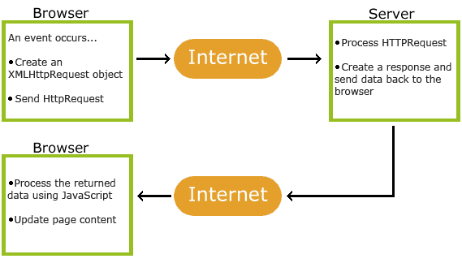
How AJAX Works ?

Slide 3
Steps
1. An event occurs in a web page (the page is loaded, a button is clicked)
2. An XMLHttpRequest object is created by JavaScript
3. The XMLHttpRequest object sends a request to a web server
4. The server processes the request
5. The server sends a response back to the web page
6. The response is read by JavaScript
7. Proper action (like page update) is performed by JavaScript

Slide 4
Create an XMLHttpRequest Object
All modern browsers (Chrome, Firefox, IE7+, Edge, Safari, Opera) have a built-in XMLHttpRequest object.
Syntax for creating an XMLHttpRequest object:
variable = new XMLHttpRequest();
Example
var xhttp = new XMLHttpRequest();

Slide 5
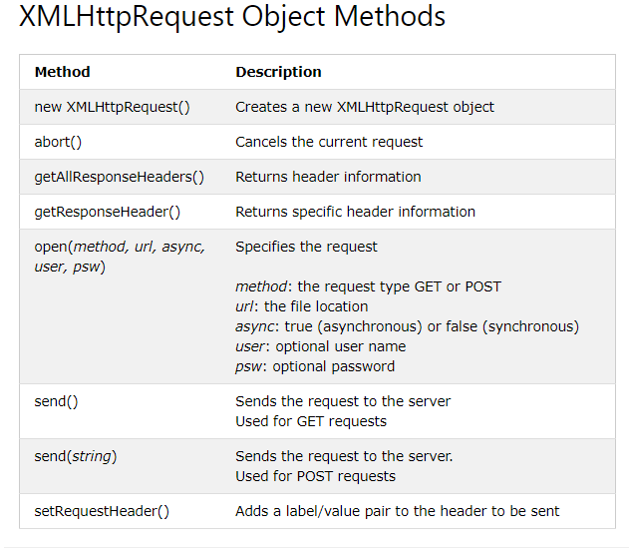

Slide 6
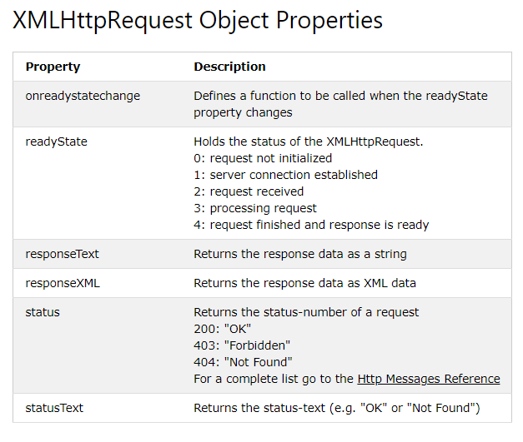

Slide 7
Note
Synchronous XMLHttpRequest (async = false) is not recommended because the JavaScript will stop executing until the server response is ready. If the server is busy or slow, the application will hang or stop.

Slide 8
Send a Request To a Server
To send a request to a server, we use the open() and send() methods of the XMLHttpRequest object:
xhttp.open("GET", "ajax_info.txt", true);
xhttp.send();

Slide 9
The onreadystatechange Property
The onreadystatechange property defines a function to be executed when the readyState changes.
The readyState property holds the status of the XMLHttpRequest.
The status property and the statusText property holds the status of the XMLHttpRequest object.
The onreadystatechange function is called every time the readyState changes.
When readyState is 4 and status is 200, the response is ready.
The onreadystatechange event is triggered four times (1-4), one time for each change in the readyState.

Slide 10
Example
function loadDoc() { var xhttp = new XMLHttpRequest(); xhttp.open("GET", "ajax_info.txt", true); xhttp.send(); xhttp.onreadystatechange = function() { if (this.readyState == 4 && this.status == 200) { document.getElementById("demo").innerHTML = this.responseText; } }; }

